Slide 1

Tele-driving Safety and
Cybersecurity Risk Assessment
Supervised by:
Presented by:
M. Saleh BENSATOR
&
Mme Mounira MSAHLI
Yves MADAKDANDI
Didier MBETSI
Franck KOUAM
Hamza TAZI
Léonce KAMGUEM
Nour KERIM HEMISS
Telecom Paris 2023-2024

Slide 2

1.
Introduction
2.
State of the art of Tele-driving
3.
Risk Analysis of Teleoperated Vehicles
4.
Car Hacking Through Frame Replay
5.
Man-in-the-middle Attack
6.
Denial of Service Attack

Slide 3
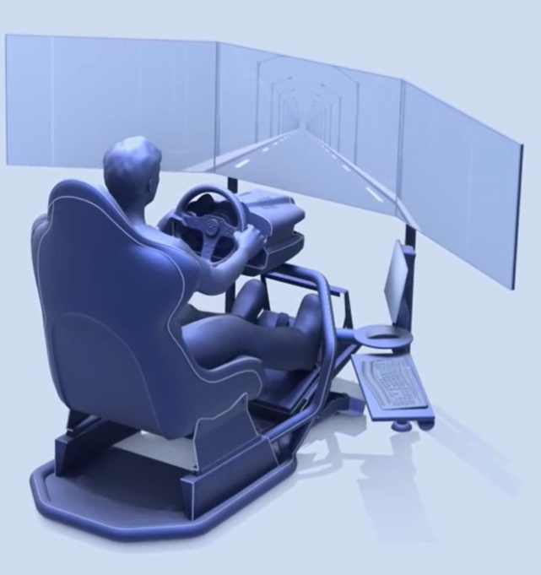
1.
Introduction

Slide 4
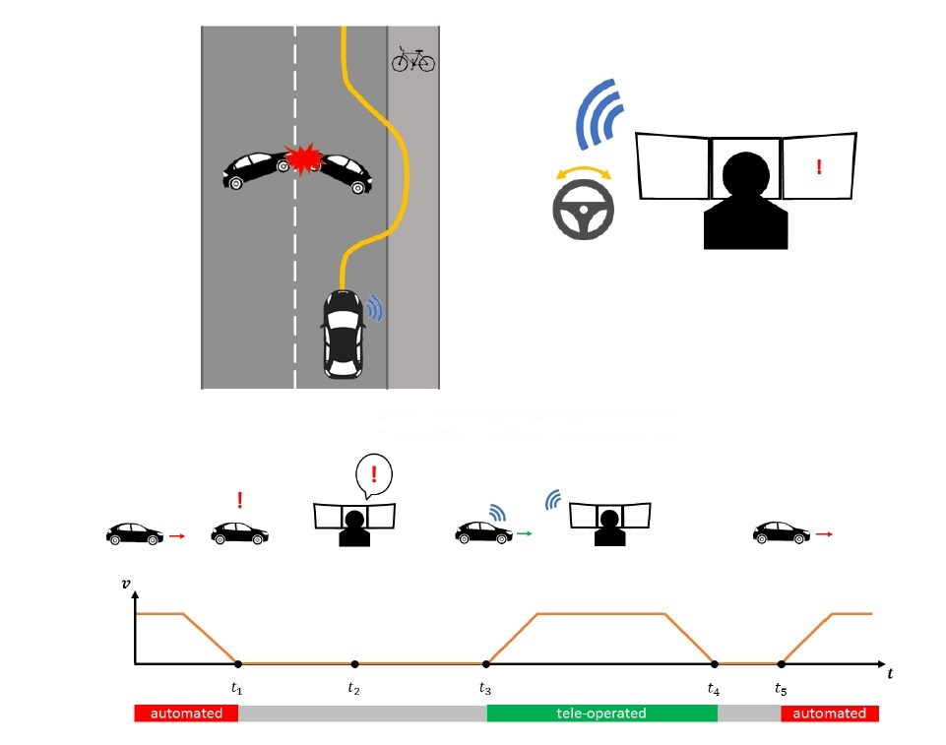
INTRODUCTION
Technological advances have led to the design of autonomous vehicles
These autonomous vehicles often find themselves in ambiguous situations requiring human intervention. Hence the development of a remote control mechanism
Our project aims to conduct an assessment of Security and Cybersecurity Risks for vehicle teleoperation and perform attack simulations (DoS and MITM).

Slide 5
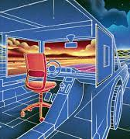
2.
State of the art of Tele-driving

Slide 6
Use Cases
Driving tasks can be divided into three types of activities:
Strategic level operations
Tactical level operations (maneuvering)
Operational level operations (or control)
There are three types of tele-driving operators based on their role in driving
The 5GAA defines two categories, A and B, based on the use case:
Category A: Type 2 Teleoperation with indirect control (ToD)
Category B: Type 3 Teleoperation with direct control (ToD)

Slide 7
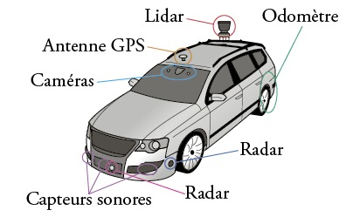
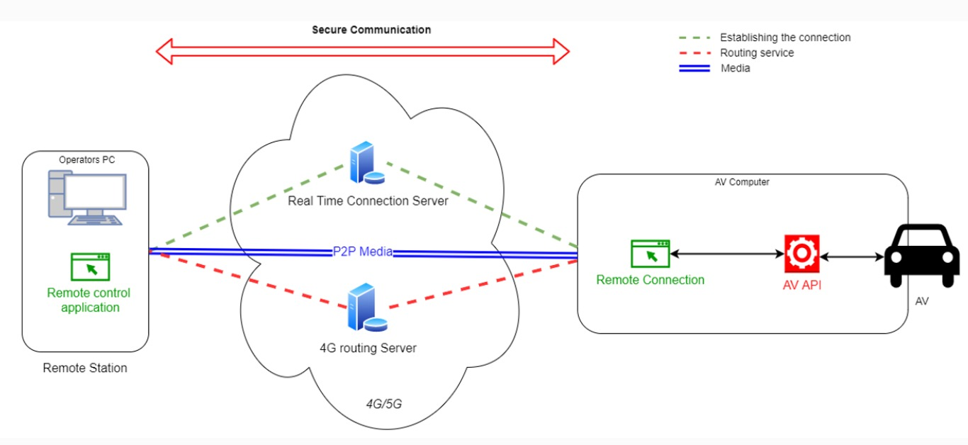
Technological Requirements
Sensors and Perception
Artificial Intelligence and Decision Making
V2X and Connected infrastructure
Communication Networks
Human-machine Interfaces
Security and Cybersecurity

Slide 8
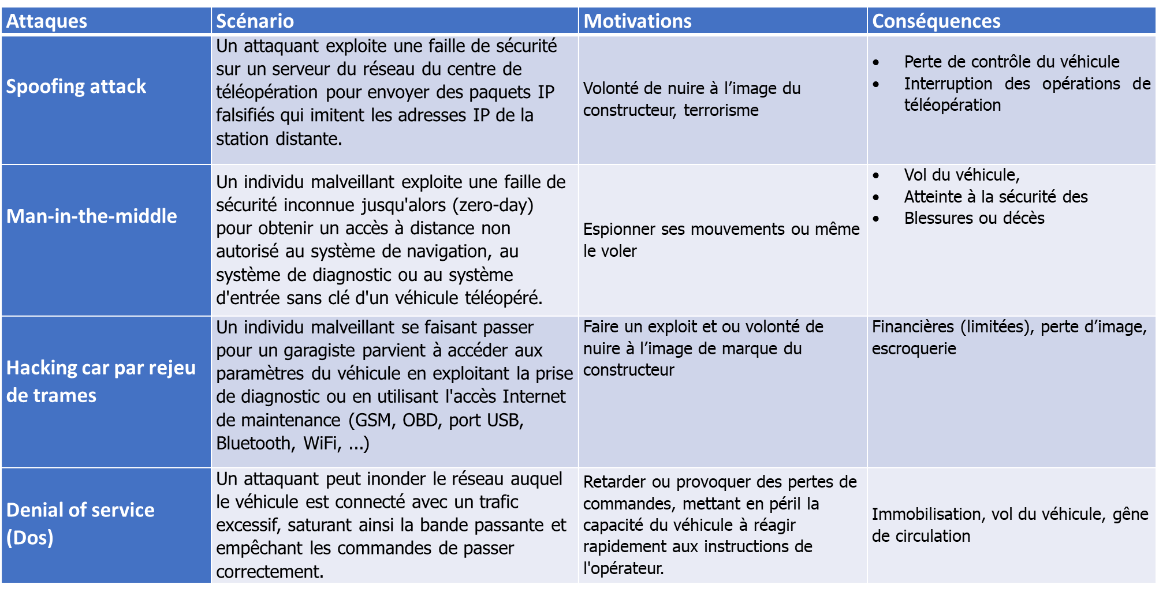
Attaques et vulnérabilités connues

Slide 9

3.
Risk Analysis of Teleoperated Vehicles

Slide 10
Identification of Target Safety and Security Objectives
Collision Prevention
Data and Communication Security
Reliability of Control System
Redundancy and Backup Systems
Training and Operator Skills
Regulatory Compliance
Data Monitoring and Analysis

Slide 11
Identification of Functional Safety and Cybersecurity Requirements (1/2)
Data Encryption: All data collected by sensors and transmitted between teleoperated vehicles and the teleoperation center must be encrypted to ensure confidentiality and prevent unauthorized interception.
Authentication and Authorization: Implement robust authentication mechanisms to ensure that only authorized users have access to data and systems.
Data Integrity: Employ data integrity verification techniques to detect any unauthorized alteration or manipulation of information collected by sensors.
Physical Security of Sensors: Physically protect sensors against any attempts of sabotage or manipulation.

Slide 12
Identification of Functional Safety and Cybersecurity Requirements (2/2)
Network and Communication Security: Implement secure communication protocols, such as HTTPS protocol for transmissions over the Internet, to protect data during transit between teleoperated vehicles and the teleoperation center.
Network Monitoring: Continuously monitor network traffic to detect any suspicious activity or intrusion attempts.
Regular Security Updates: Keep the software and systems of teleoperated vehicles and the teleoperation center up to date to address known security vulnerabilities and prevent potential attacks.
Personnel Training: Raise awareness among staff about information security and provide training on best practices in cybersecurity, including password management, threat recognition, and secure data handling.

Slide 13
Risk Analysis (1/2)
The following steps allow for identifying risks related to an attack against teleoperated vehicles:
Asset Identification: The assets to protect in this case are the teleoperated vehicles, the vehicle control system, the vehicle sensor data, and the vehicle communication network.
Threat Identification: Potential threats include malicious hackers, nation-states, and criminal groups.
Vulnerability Identification: Vulnerabilities in teleoperated vehicles include security flaws in software and communication systems, as well as physical security vulnerabilities in the vehicles themselves.
Identify Attack Scenarios: A typical MITM attack scenario involves a hacker intercepting communication between the teleoperated vehicle and its operator, then altering the instructions sent to the vehicle. This could result in loss of vehicle control, accidents, injuries, or even fatalities.

Slide 14
Risk Analysis (2/2)
Attack Scenario | Description | Control Measures | Exposition | Controllability | Severity
Denial of Service Attack (DoS) | A hacker floods the teleoperated vehicle with network traffic, preventing it from receiving instructions from the operator. This can lead to loss of vehicle control, accidents, injuries, or even fatalities. | Implementation of firewalls and Intrusion Detection Systems (IDS) to block DoS attacks. Deployment of a failover system to allow the teleoperated vehicle to operate in case of primary network failure. | E2 1% | C1 0 .1% | S4 (Potentially fatal or uncertain survival)
Man in the Middle Attack (MitM) | A hacker intercepts communication between the teleoperated vehicle and the operator, spying on the exchanged data. This may include sensitive information such as the vehicle's position, speed, and the operator's identity. | Encryption of communications between the teleoperated vehicle and the operator. Mutual authentication between the teleoperated vehicle and the operator. | E2 1% | C2 1% | S1 No injuries

Slide 15
4.
Car Hacking Through Frame Replay

Slide 16
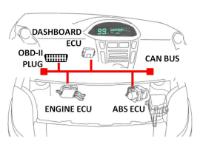
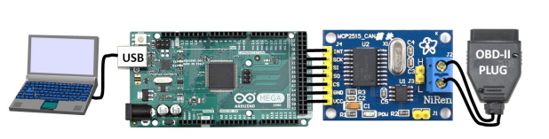
Car Hacking Through Frame Replay 1/2
The attack is conducted using a device made from an Arduino and a CAN bus controller MCP2515, which allows the attacker to intercept and analyze messages exchanged on the vehicle's CAN bus by listening to actions such as button presses or reading error codes through the vehicle's OBD port.

Slide 17
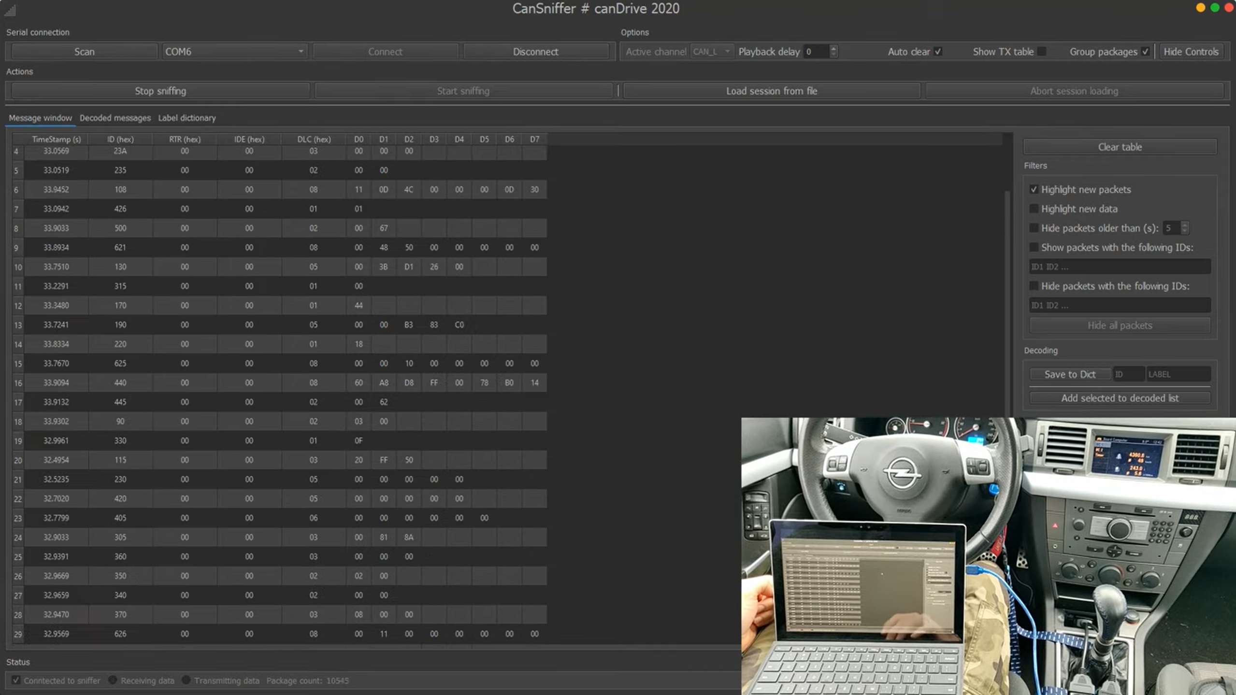
Car Hacking Through Frame Replay 2/2
Message Analysis: The hacker examines the captured messages and identifies the specific data packet associated with the button action. They label this packet for future reference.
Action Testing: The hacker sends this specific packet to the car to confirm that it indeed triggers the action associated with the button.
Repeating for Other Buttons: The hacker repeats this process for other buttons in the car, capturing, analyzing, and testing the messages associated with each action.
Exploration of Advanced Features: Using the sniffer, the hacker explores more advanced features of the car, such as controlling the engine RPM, reading error codes from the ECU (Electronic Control Unit), and even output tests like testing the dashboard needles.

Slide 18
5.
Man-in-the-middle Attack

Slide 19
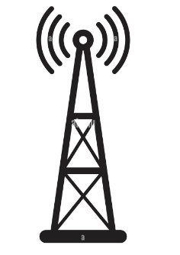
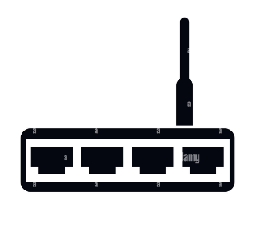

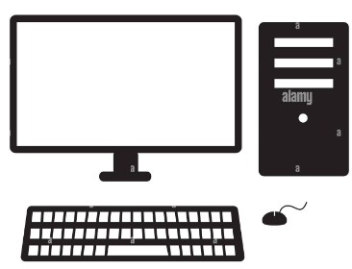


Analogy between simulation and real teledriving
Router represents the network
Laptop2 represents the vehicle
Laptop 1 represents the teleoperator.
Attacker's laptop

Slide 20
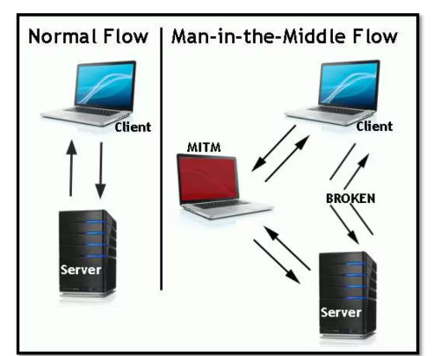
Principle of the Man-in-the-Middle Attack (1/2)
The principle of the man-in-the-middle (MITM) attack is to intercept, modify, or manipulate the exchanged data by positioning oneself between two communicating parties. The attacker places themselves so that both parties believe they are communicating directly with each other, when in reality, all communications pass through the attacker.

Slide 21
Principle of the Man-in-the-Middle Attack (2/2)
There are several types of man-in-the-middle attacks:
IP spoofing
DNS spoofing
HTTPS spoofing
SSL hijacking
ARP poisoning
In our case, we will carry out the ARP poisoning attack.

Slide 22
Attack Preparation (1/2)
We have set up a local network using a WIFI router. The LAN network consists of 3 PCs with the following addressing:
PC Operation System | IP Adresse | role | Tools
WINDOWS 11 | 192.168.8.101/24 | Broadcast the vehicle's video stream to the network | OBS, NFS
MAC | 192.168.8.100/24 | Receive the video stream and display it on the MPV player | MPV
Linux Ubuntu | 192.168.8.102/24 | Perform the man-in-the-middle attack to intercept the video stream and view it. | Ettercap, wireshark, SCAPY, MPV

Slide 23
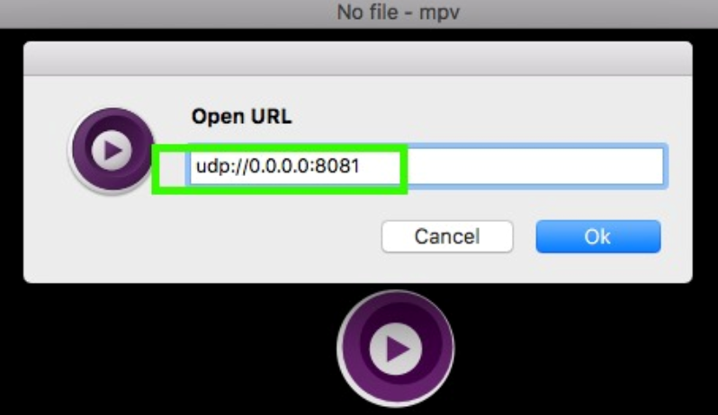
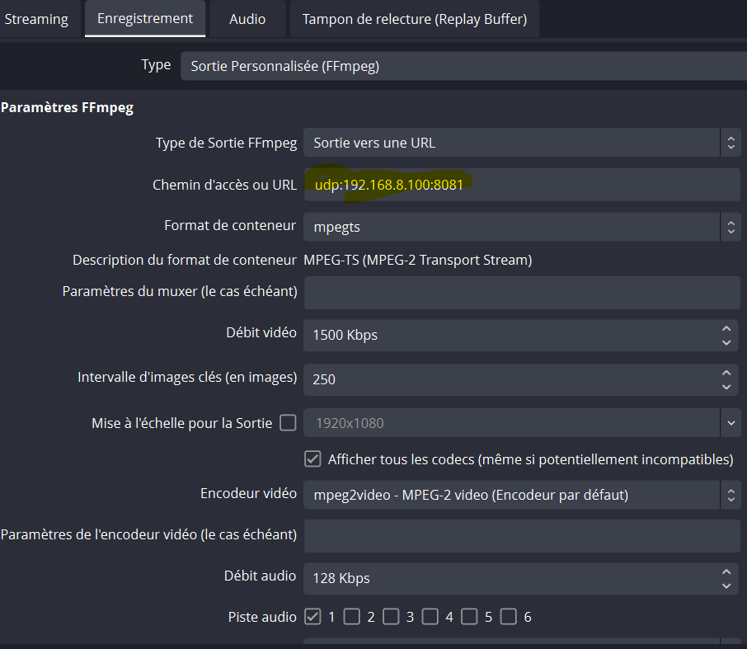
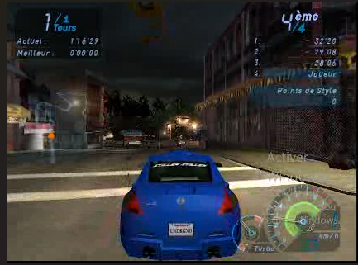
Attack Preparation (2/2)
On the WINDOWS 11 machine, we configured OBS and broadcasted the video stream using the UDP protocol to the Mac machine (192.168.8.100). The Mac machine receives the video, allowing us to start our attack.

Slide 24
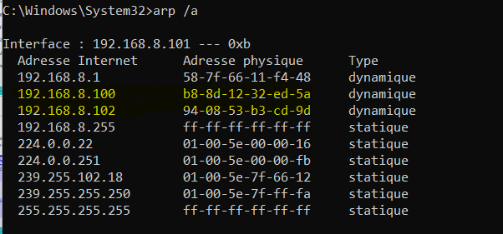
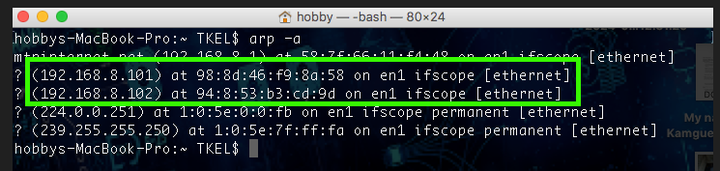
Attack Execution (1/3)
Our attack involves ARP poisoning as a man-in-the-middle type. Before launching the attack, we first present the ARP tables of the MAC and WINDOWS machines.

Slide 25
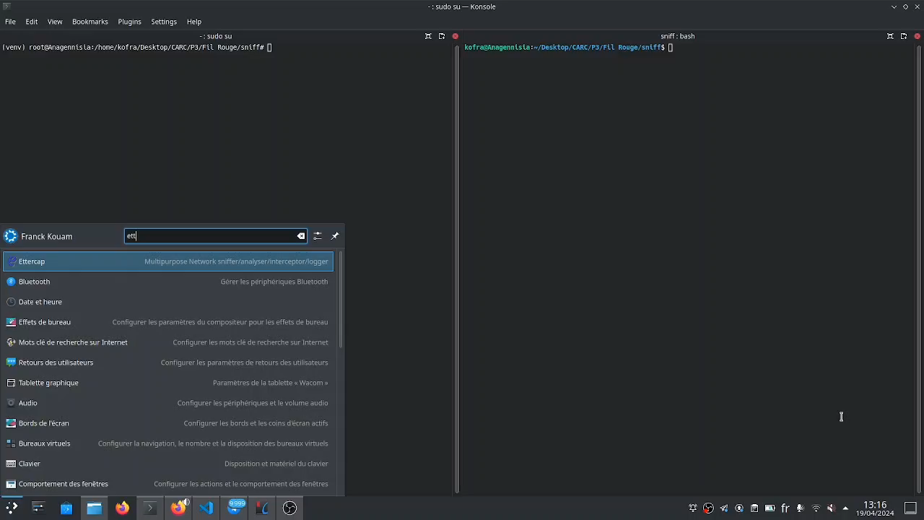
Attack Execution (2/3)
From the Linux-Ubuntu machine, we launch the ARP poisoning attack targeting the MAC and WINDOWS machines.

Slide 26
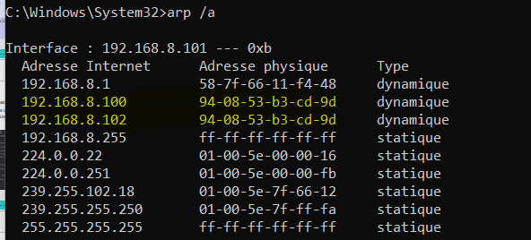
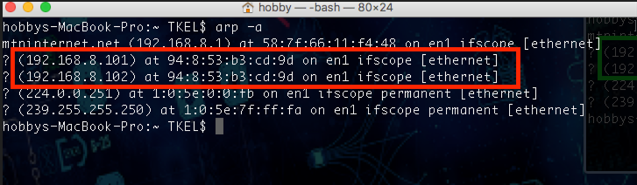
Attack Execution (3/3)
After the attack, we can observe what happened in the ARP table of the target machines.

Slide 27
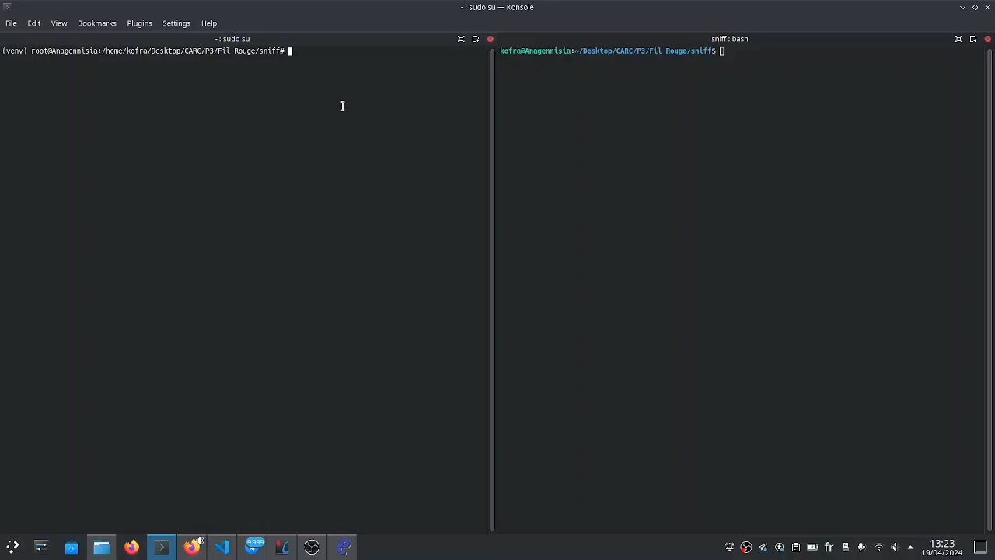
Exploitation of the Attack
We can observe on Wireshark all the packets read by the attacking machine. Using the SCAPY library, we can record the packets as an MP4 file and play the content using an MPV player.

Slide 28
Attack Conclusion
The attack was successfully carried out.
We were able to read the packets exchanged between the 2 target machines using Wireshark.
With the SCAPY library, we recorded the content of these packets into an MP4 file and played it with the MPV player.

Slide 29
6.
Deni al of Service Attack

Slide 30
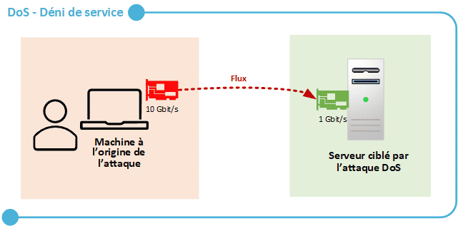
Principle of the DOS Attack (1/2)
A denial-of-service (DOS) attack involves sending numerous malicious requests to a service to overwhelm it. The website, network, application, etc., becomes inaccessible, and legitimate requests from real users can no longer be processed.

Slide 31
Principle of the DOS Attack (2/2)
The most common DoS attacks are:
UDP flood
DNS reflection/amplification
ICMP flood
SYN flood
Smurf
In our case, we will carry out the ICMP flood attack

Slide 32
Preparation of the Attack (1/2)
In the same local network, this time we are using 2 Windows PCs and 1 Mac PC.
PC Système d’exploitation | Adresse IP | rôle | Applications installées
WINDOWS 11 | 192.168.8.101/24 | Broadcast the vehicle's video stream to the network. | teamviewer, NFS
WINDOWS 11 | 192.168.8.100/24 | Receive the video stream through TeamViewer. | teamviewer
MAC | 192.168.8.102/24 | Perform the DoS attack. | Ping command

Slide 33
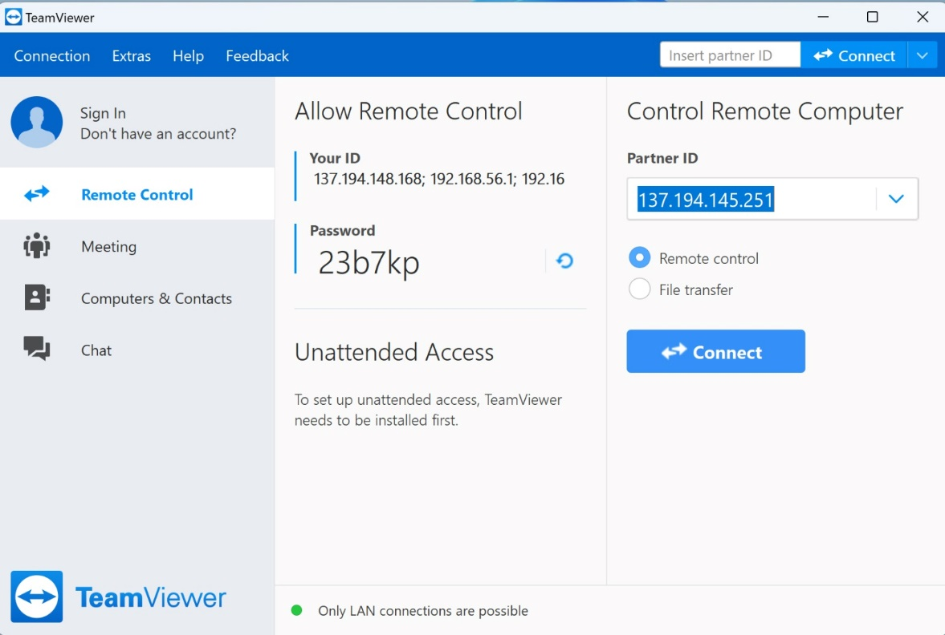
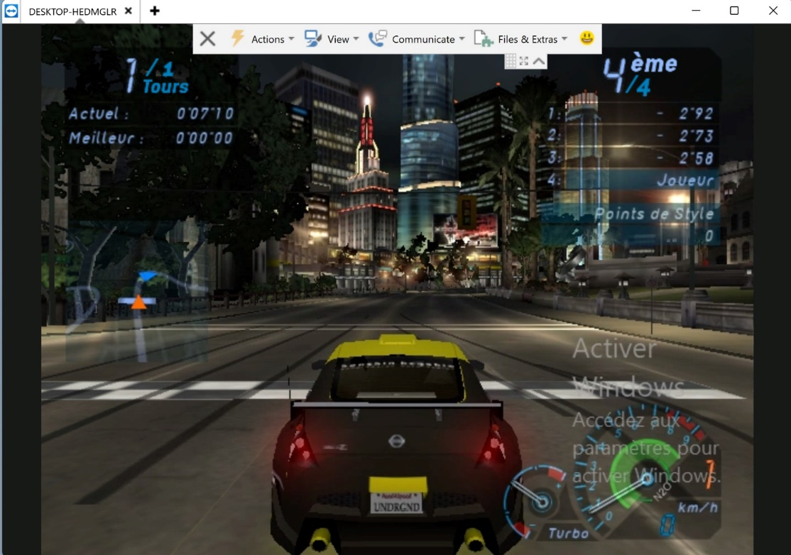
Preparation of the Attack (2/2)
We installed TeamViewer on a Windows machine on the local network and started the NFS application. Then, on another Windows machine, we also installed TeamViewer and configured the connection to remotely control the first machine.

Slide 34
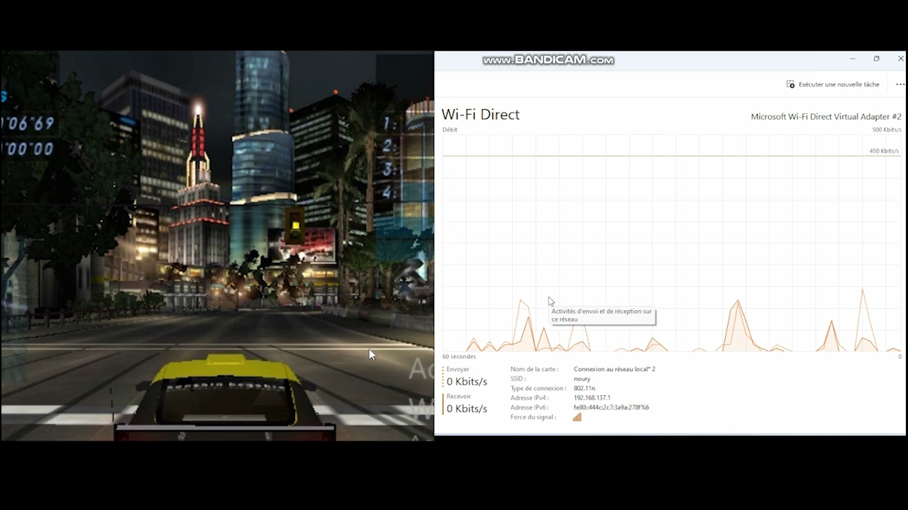
Execution of the Attack
Command on the MAC machine: ping 192.168.137.1 -s 1400 -t 3600 -i 0.000001

Slide 35
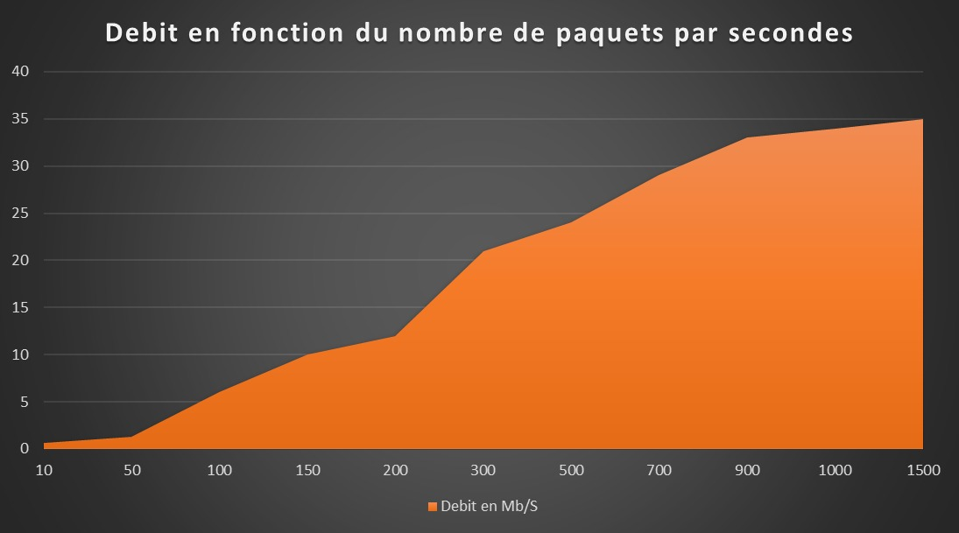
Execution of the Attack
We noted the saturation rate on the network based on the number of packets sent per second in the ICMP flood command, and we observed that we started to feel slowness starting from 300 packets per second.
Slowness is felt starting from 300 Mbps.

Slide 36

Questions ?

